Slide 1
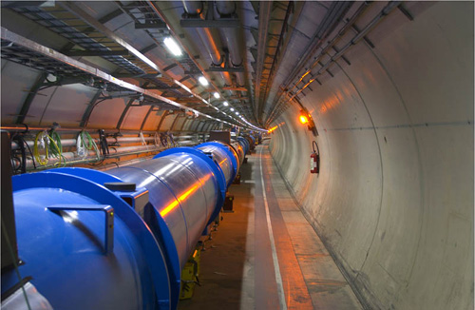
Data Lifecycle Management Challenges and Techniques
- a user’s experience
Luca Canali, Jacek Wojcieszuk, CERN
UKOUG Conference, Birmingham, December 1st, 2010

Slide 2
Outline
CERN, LHC and Database Services at CERN
Motivations for Data Life Cycle Management activities
Techniques used
Sharing our experience with examples

Slide 3

Balloon
(30 Km)
CERN and LHC
CD stack with
1 year LHC data!
(~ 20 Km)
CERN – European Organization for Nuclear Research – located at Swiss/French border
LHC – Large Hadron Collider – The most powerfull particle accelerater in the world – launched in 2008
Concorde
(15 Km)
LHC data correspond to about
20 million CDs each year!
Mt. Blanc
(4.8 Km)
RDBMS play a key role for the analysis of LHC data

Slide 4
LHC and Databases
Relational DBs play today a key role for LHC Physics data processing
  online acquisition, offline production, data (re)processing, data distribution, analysis
    SCADA, conditions, geometry, alignment, calibration, file bookkeeping, file transfers, etc..
  Grid Infrastructure and Operation services
    Monitoring, Dashboards, User-role management, ..
  Data Management Services
    File catalogues, file transfers and storage management, …
  Metadata and transaction processing for custom tape-based storage system of physics data
  Accelerator logging and monitoring systems
Notes:
Originally deployed at CERN for the construction of LEP, relational databases now play a key role in the experiments' production chains, from online acquisition through to offline production, data distribution, reprocessing and analysis
Listed among the critical services for the LHC experiment

Slide 5
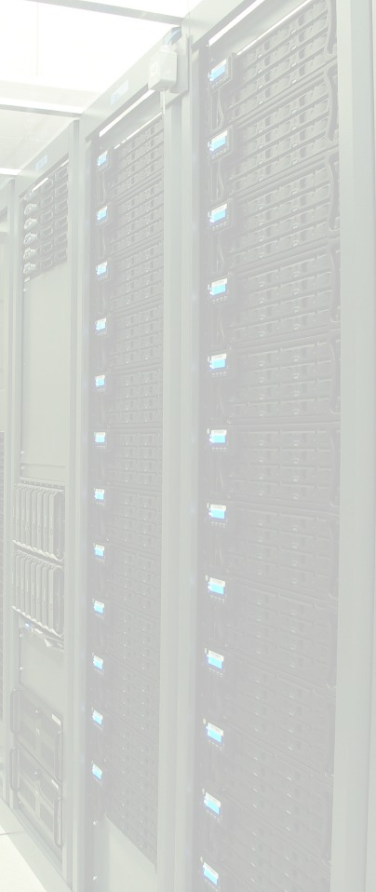
CERN Databases in Numbers
CERN databases services – global numbers
  Global users community of several thousand users
  ~100 Oracle RAC database clusters (2 – 6 nodes)
  Currently over ~3000 disk spindles providing more than ~3PB raw disk space (NAS and SAN)
Some notable DBs at CERN
  Experiment databases – 13 production databases
    Currently between 1 and 12 TB in size
    Expected growth between 1 and 19 TB / year
  LHC accelerator logging database (ACCLOG) – ~50 TB
    Expected growth up to 30 TB / year
  ... Several more DBs on the range 1-2 TB

Slide 6
Data Lifecycle Management
„Data Lifecycle Management (DLM) is a policy-based approach to managing the flow of an information system’s data throughout its lifecycle”
Main challenge:
  Understand how data evolves
  Determine how it grows
  Monitor how its usage change
  Decide how long it should survive
ACTIVE
LESS ACTIVE
HISTORICAL
ARCHIVE

Slide 7
Data Lifecycle Management
@CERN
Motivated by large data volumes produced by LHC experiments
  Large amounts of data are being collected and stored for several years
  Different requirements on performance and SLA can often be found for ‘current’ and ‘old’ data sets
Proactively attack ‘issues’ of databases that grow ‘too large’
  Administration
  Performance
  Cost

Slide 8

Attack Problem from Multiple Sides
No out of the box solutions available
Attack the problem where possible
  HW architecture
  Applications
  Oracle and DB features
Application layer
  Focus on discussing with developers
  Build life cycle concepts in the applications
Oracle layer
  Leverage partitioning and compression
  Movement of data to an external ‘archival DB’

Slide 9


Commodity HW
Dual-socket quad-core DELL blade servers, 24GB memory, Intel Xeon “Nehalem”; 2.27GHz
Dual power supplies, mirrored local disks, redundant 1GigE, dual HBAs, “RAID 1+0 like” with ASM and JBOD
RAC DB 1
RAC DB 1
Ethernet Swiches
FC Switches
RAC DB 2
RAC DB 2

Slide 10

High Capacity Storage, Resiliency and Low Cost
Low cost HA storage with ASM
Latest HW acquisition:
  852 disks of 2TB each -> almost 1,7 PB of raw storage
  SATA disk for price/perf and high capacity
  Single controller
ASM provides redundancy (mirroring) and striping
De-stroking can be used (external part for data)
  11g Inteligent Data Placement can be used instead
Failgroup1
Failgroup2
Failgroup3
Failgroup4
DATA_DG1
RECO_DG1

Slide 11
Backup Challenges
Backup/recovery over LAN becoming problem with databases exceeding tens of TB
  Days required to complete backup and recovery
  Incompatible with SLA for many production systems
Mitigation:
  Incrementally updated image copy helps to workaround the problem
    Typically not sufficient for disaster recovery
  Backups over 10 Gb Ethernet
  Backups over SAN
    Media management server used only to register backups
    Very good performance observed during tests (~200MB/s per RMAN channel)

Slide 12
Physical Standby DB
Can become also a backup solution for VLDBs
Offers almost real-time service recovery
Can be used to offload the primary DB:
  To handle logical corruptions – if flashback database enable
  To take backups
  To run queries – with 11g and Active Data Guard
  To export data
Primary DB
Standby DB
Redo Stream

Slide 13
Application Layer
Data Life Cycle policies cannot be easily implemented from the DBA side only
We make sure to discuss with application developers and application owners
  To reduced amount of data produced
  To allow for DB structure that can more easily allow archiving
  Define data availability agreements for online data and archive
  Identify how to leverage Oracle features for VLDBs

Slide 14
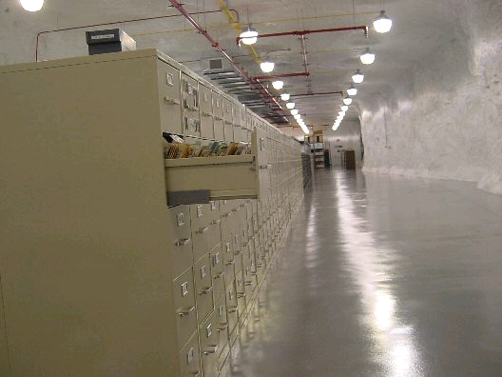
Use Case: Transactional Application with Historical Data

Slide 15
Active Dataset
  At a given time only a subset of data is actively used
Typical for many physics applications
  Typically time-organized data
  Natural optimization: having large amounts of data that are set read only
    Can be used to simplify administration
    Replication and backup can profit too
  This leads to range-based partitioning
    Oracle partitioning
    Manual split

Slide 16

Techniques: Oracle Partitioning
Typically range partitioning on timestamp attributes
Mature and widely used technology
Almost transparent to applications
Can improve performance
  Full scan operation, if they happen, do not span whole tables
Important improvements in Oracle 11g
  Interval partitioning – automatic creation of partitions for ‘future time ranges’
  11g reference partitioning

Slide 17
Oracle Partitioning Issues
Index strategy
  Indexes need to be local partitioned in the ideal case to fully make use of ‘partition isolation’
    Often impossible for unique indexes
  Depends on application
  Sometimes global indexes better for performance
Data movement issues
  Using ‘Transportable tablespaces’ for single partitions is not straightforward
Query tuning
  App owners and DBAs need to make sure there are no ‘stray queries’ that run over multiple partitions by mistake

Slide 18
Oracle Partitioning for DLM and Indexes
Local-partitioned indexes preferred
  That is index partitioned as the table
  Good for maintenance, often also for performance
  Sometimes problematic for queries
  Important limitation: columns in unique indexes need be superset of partitioning key
    May require disabling PK/UKs
    Or changing PK/UKs to include partitioning key
DDL operations on partitions makes global indexes unusable
  ‘update global indexes’ option helps but makes whole operation much slower

Slide 19
Example: PANDA Archive
GRID jobs’ monitoring system
  Schema contains historical data coming from production
  Currently 1.2 TB of data
DLM implementation
  Oracle partitioning by time range
    One partition per 3 days
    Query speed-up because of partition-pruning
  One tablespace per year
  All indexes are local
    Compromise change -> unique index on panda_id changed to be non-unique to use partitioning
  Old partitions can be moved to archive system
Performance
  Application modified to add time range in all queries -> to use partition pruning

Slide 20
Techniques: ‘Manual’ Partitioning
Range partitioning obtained by creating multiple schemas and sets of tables
  Flexible, does not require partitioning option
    And is not subject to partitioning limitations
  Much more work goes into the application layer
    Application needs to keep track of ‘catalog’ of partitions
CERN Production examples
  PVSS (commercial SCADA system)
  COMPASS (custom development at CERN)

Slide 21
Example: PVSS
Main ‘event tables’ are monitored to stay within a configurable maximum size
  A new table is created after the size threshold is reached
  PVSS metadata keep track of current and historical tables
  Access to data using ‘UNION ALL’ view
  Additional partitioning by list on sys_id for insert performance
  Historical data can be post-processed with compression
Current size (Atlas experiment): 5.8 TB
TAB_1
TAB_2
TAB_3
TAB_4

Slide 22
Example: COMPASS
Each week of data is a separate table
  In a separate schema too
    raw and re-processed data also separated
    The aplication maintains a catalog
  IOT used
  Up to 4.6 billion rows per table
  Key compression used for IOT
Current total size: ~12 TB
  Biggest table 326 GB

Slide 23
Techniques: Schema Reorganization
When downtime of part of the application can be afforded
  Alter table move (or CTAS)
  Alter index rebuild
    Online rebuild also possible
More sophisticated
  DBMS_REDEFINITION
  Allows to reorganization of tables online (add partitioning for example)
  Users experience, works well but it has let us down a couple of times in presence of high transaction rates
    hard to debug and test ahead

Slide 24
Techniques: Archive DB
Move data from production to a
separate archive DB
  Cost reduction: archive DB is sized
  for capacity instead of IOPS
  Maintenance: reduces impact of production DB growth
  Operations: archive DB is less critical for HA than production
Goes together with the partitioning approach
Main problem: how to move data to archive and possibly back in case of a restore?
  It’s complicated by referential constraints
Main DB
Archive DB
Old tables/partitions

Slide 25
Archive DB in Practice
Detach ‘old’ partitions form prod and load them on the archive DB
  Can use partition exchange to table
  Transportable tablespaces is a tool that can help
  Post-move jobs can implement compression and drop indexes
Difficult point:
  One needs to move a consistent set of data
  Applications need to be developed to support this move
    Access to data of archive need to be validated
    Database links, views and synonyms can help to hide data distribution
    New releases of software need to be able to read archived data

Slide 26
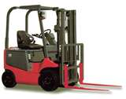
Techniques: Data Movement
Create table as select over a DB link
  Good enough for single tables/partitions
  Too laborious if many objects needs to be copied
impdp/expdp
  Very useful although performance issues found
  Impdp over DB link in particular
Partitioning and data movement
  Exchange partition with table
Transportable tablespaces
  Very fast Oracle-Oracle data movement
  Requires TBS to be set read only
    Can be a problem in production

Slide 27
Transportable Tablespaces and Standby DBs
Physical standby database can be used as a source for transportable tablespaces procedure
  Standby needs to be opened in read-only mode
  Active Data Guard option not needed
  DBMS_FILE_TRANSFER package to copy datafile
    Much faster than scp
  impdp over a DB link to export/import metadata
    If 10.2.0.4 or 11.1.0.6 patch 7331929 needed
    10.2.0.5 and 11.1.0.7 patchsets include the fix
  With Flashback Database feature enabled one can also temporarily open a physical standby DB read-write

Slide 28
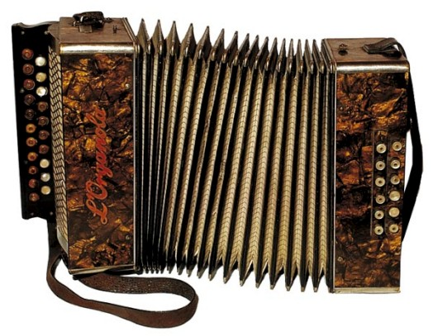
Techniques: Compression
Another tool to control DB growth
  Several compresion techniques available in Oracle RDMBS
  Especially useful if spare CPU cycles available
  Can help in reducing physical IO

Slide 29

Oracle Segment Compression -What is Available
Heap table compression:
  Basic (from 9i)
  For OLTP (from 11gR1)
  11gR2 hybrid columnar (11gR2 exadata)
Other compression technologies
  Index compression
    Key factoring
    Applies also to IOTs
  Secure files (LOB) compression
    11g compression and de-duplication
  Compressed external tables (11gR2)

Slide 30

Evaluating Compression Benefits
Compressing segments in Oracle
  Save disk space
    Can save cost in HW
    Beware that capacity in often not as important as number of disks, which determine max IOPS
  Compressed segments need less blocks so
    Less physical IO required for full scan
    Less logical IO / space occupied in buffer cache
    Beware compressed segments will make you consume more CPU

Slide 31

Making it Work with Applications
Evaluate gains case by case
  Not all applications can profit
  Not all data models can allow for it
  Compression can give significant
  gains for some applications
  In some other cases applications can be modified to take advantage of compression
Comment:
  Implementation involves developers and DBAs
  DBMS_COMPRESSION package to evaluate possible gains

Slide 32
Compression and Expectations
A 10TB DB can be shrunk to 1TB of storage with a 10x compression?
  Not really unless one can get rid of indexes
    Applies more to DW
  Often indexes’ compression is lower than tables’
    So archive can be dominated by indexes size
Licensing costs
  Advanced compression option required for anything but basic compression
  Exadata storage required for hybrid columnar compression

Slide 33
Table Compression In Practice
‘Alter table move’ or online redefinition to populate compressed segments
  See earlier comments regarding online redefinition
Measured compression factors for tables:
  About 3x for BASIC and OLTP
    Important to sort properly data while populating compressed tables
  10-20x for hybrid columnar (archive)

Slide 34
Conclusions
Data Life Cycle Management experience at CERN
  Proactively address issues of growing DBs
  manageability
  performance
  cost
Involvement of application owners is fundamental
Techniques within Oracle that can help
  Partitioning
  Archival DB service
  Compression

Slide 35
Conclusions
Data Life Cycle Management experience at CERN
  Proactively address issues of growing DBs
  Manageability
  Performance
  Cost
Involvement of application owners is fundamental
Techniques within Oracle that can help
  Partitioning
  Archival DB service
  Compression

Slide 36
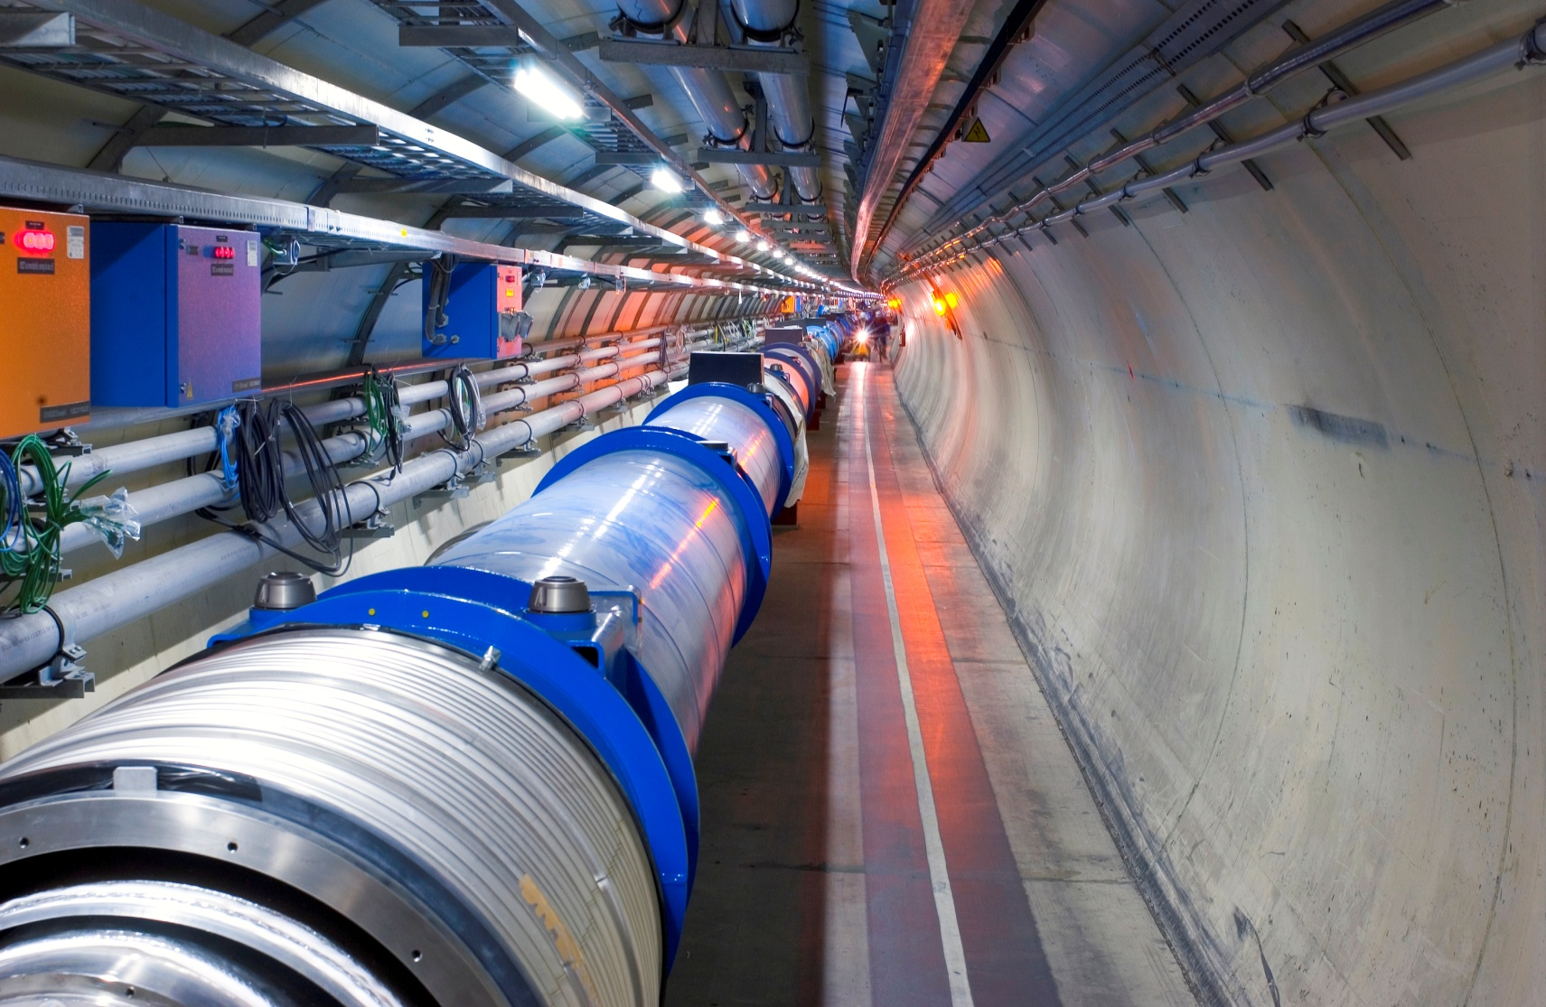
Acknowledgments
CERN-IT DB group and in particular:
    Dawid Wojcik
    Marcin Blaszczyk
    Gancho Dimitrov (Atlas experiment)
More info:
http://cern.ch/it-dep/db
http://cern.ch/canali

